Slide 1
Secure Data Hiding in Image Using Steganography
Presented By: Samruddhi Jagtap.
College Name: Ajinkya DY Patil School of Enginerring
Department: Electronic & Communication

Slide 2
OUTLINE
Problem Statement
Technology used
Wow factor
End users
Result
Conclusion
Git-hub Link
Future scope

Slide 3
Problem Statement
With the growing need for secure communication, traditional encryption methods often face vulnerabilities. Steganography, the practice of hiding data in digital media, offers a solution by embedding sensitive information within images, making it undetectable. This project focuses on developing a Secure Data Hiding System using steganography, where data is securely embedded in an image without altering its visual quality.

Slide 4
Technology used
Programming Languages:
Python: Popular for implementing steganography due to its simplicity and rich library support.
C/C++: Used for performance optimization in data hiding algorithms.
Libraries:
OpenCV: A powerful library for image and video processing in Python, useful for manipulation and analysis of images.
PyCryptodom:- Python library for encryption and decryption of data before embedding.
NumPy: For numerical operations, especially with pixel data arrays in images.
Stegano: A Python library specifically designed for implementing steganography.
PyCharm:
PyCharm is a popular Integrated Development Environment (IDE) for Python programming, developed
by JetBrains. A Python distribution for managing libraries and packages, ideal for data science and security-related projects.

Slide 5
Wow factors
Dual Layer of Security: Combines encryption and steganography for enhanced protection.
Invisible Data Embedding: Uses LSB techniques, ensuring no visible image quality loss.
Robust Against Attacks: Resilient to compression, cropping, and resizing.
Data Integrity Maintenance: Ensures full recovery of original data without corruption.
Cross-Platform Compatibility: Works on Windows, macOS, and Linux.
Customizable and Scalable: Easily adaptable to handle more data or different image formats.

Slide 6
End users
Military and Defense Organizations:
To transmit secure messages and intelligence covertly, preventing unauthorized interception and ensuring confidentiality during communication.
Cybersecurity Professionals:
For developing secure systems that use steganography to hide data within digital media for protecting information against unauthorized access.
Digital Content Creators:
For watermarking images or embedding hidden information in digital media for copyright protection or secure distribution.

Slide 7
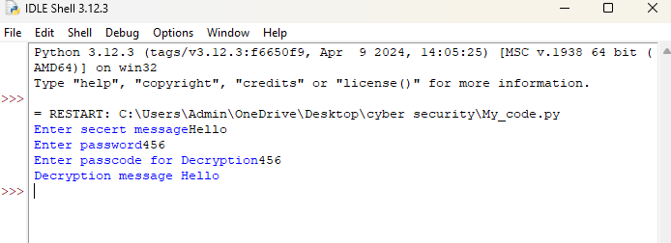
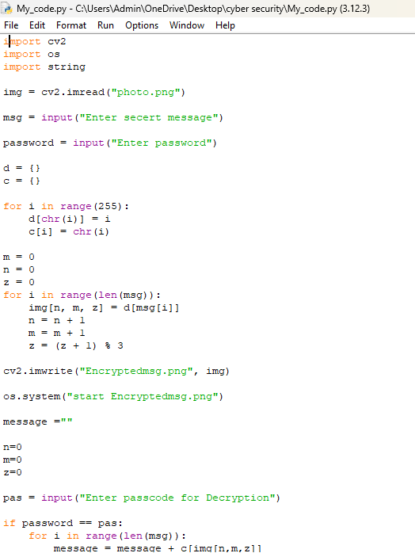
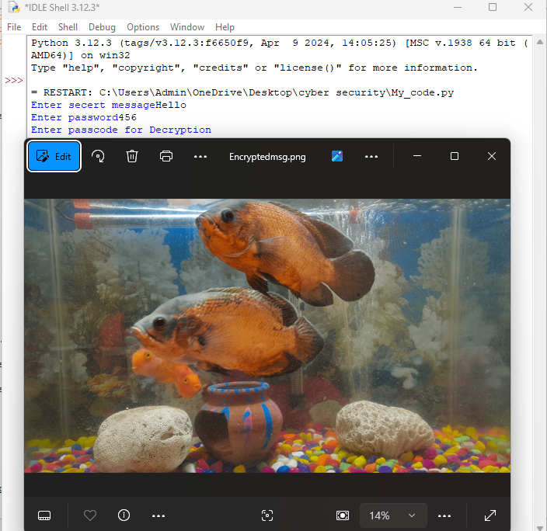
Results

Slide 8
Conclusion
The Secure Data Hiding in Image Using Steganography project provides a reliable method for securely transmitting sensitive information. By combining encryption and steganography, it ensures dual-layer security, protecting data while hiding it within images without affecting their visual quality. The system is resistant to attacks like compression and resizing, ensuring data integrity and confidentiality. Its scalability, flexibility, and cross-platform compatibility make it suitable for government, law enforcement, businesses, and individuals. Overall, the project offers a secure and efficient solution for private, untraceable communication in the digital age.

Slide 9
GitHub Link
https://github.com/Samruddhi645/Cyber_Security_Samruddhi.git

Slide 10
Future scope(optional)
Integration of Advanced Cryptography
Multi-layer Steganography
AI and Machine Learning for Detection Prevention
Mobile Application Integration
Improved Error Correction and Recovery
Blockchain Integration
These future advancements can further enhance the capability, security, and practicality of steganography for data hiding, making it even more robust and applicable in a wide range of fields.

Slide 11
THANK YOU

